Slide 1
FEEDING THE world
Name
Date

Slide 2
About Me
Where I work
Job title
A little about me
Notes:
Hi, my name is __________________ and I work for ___________________ doing ____________________.
Introduce a little about yourself. We will talk a little more about my career later on.

Slide 3
By 2050, our worlds population will top ten billion people!
How will farmers produce enough food?
Notes:
Did you realize that in the year 2050, which is only _____ years away, the world's population will be more than10 billion people? Think about that for a second, that is the number 10 with nine zeros behind it. That is a lot of people. The current world population is 7.5 billion people.

Slide 4
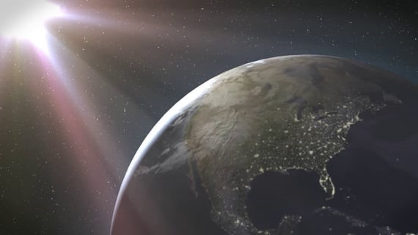
Play Earth as an apple video now
Notes:
Pay close attention to this video. I want to discuss several aspects of the video.

Slide 5
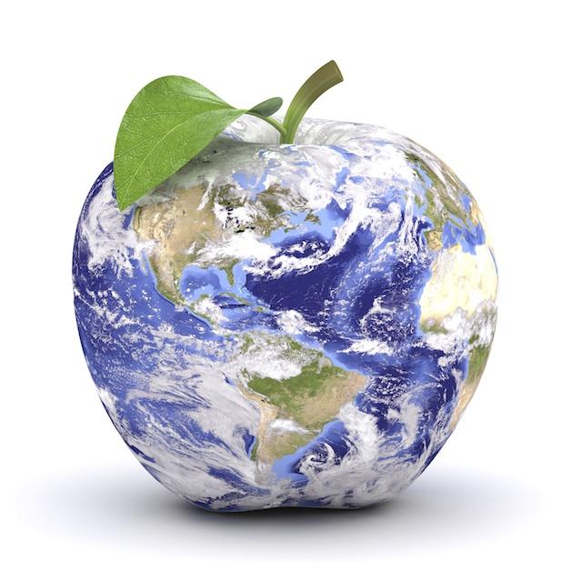
Major Concepts::
Only a small portion of Earth’s surface is used to grow food
Only 1/32 piece of the apple represents the land that is suitable to produce the world’s food
Notes:
Did you notice what a small portion of the apple was used to produce food in the video? Only 1/32 of the apple and in 2050 10 billion people will live on earth.
Lets take a second and let that soak in. Any questions?

Slide 6
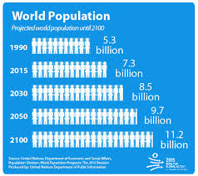
The world's population is growing at a steady rate
Notes:
Look at the world population chart. Let's compare the growth from 1990 to 2050. How many more people will be living on earth?

Slide 7
Unless food productivity increases, more land will have to be farmed
Notes:
Where will this land come from? This is one of the tough questions that farmers are facing today.

Slide 8
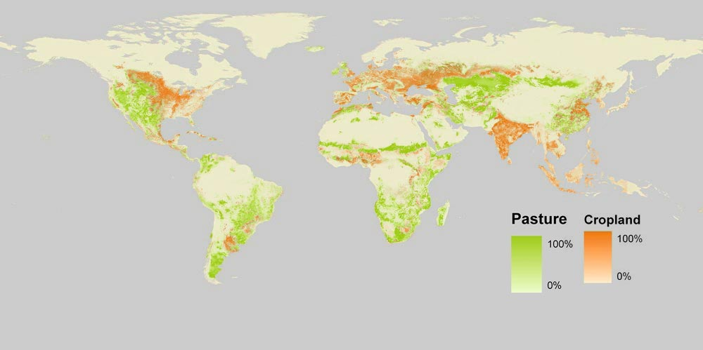
Why is land a precious resource?
Agricultural Land:
3% of Earth has ideal crop growing conditions (arable land = cropland).
With best management practices, innovation and technology we can use nearly 40% of the total land to grow food or provide grazing for livestock.
China
India
Notes:
If time permits:
Explain that farmers have increased yields (food production) by using improved practices, science and technology. For example, plant scientists have developed plants that are resistant to insects, disease and drought; soil scientists and land managers have developed soil conservation practices; and irrigation engineers have developed systems and delivery mechanisms to minimize water use and still grow a bountiful crop.
Image attributed to: https://ourworldindata.org/land-use-in-agriculture/

Slide 9
“A few billion people would have to die if we hadn’t come up with fertilizer”
–Bill Gates
Notes:
Do you know who Bill Gates is? He is the Principal founder of Microsoft
Is He a farmer? No. Mr. Gates recognizes that fertilizer saves lives because farmers are able to produce more food because of it. More food means people don't have to starve. Ensuring we are able to produce ore on less land than in years past is important, especially when we talk about the population statistics.

Slide 10
Fertilizers help increase food productivity
Nitrogen (N) Phosphorus (P) and Potassium (K) are the nutrients plants consume
Notes:
Plants, like all living things, absorb nutrients from the soils as they grow. The nutrients plants absorb in large amounts are Nitrogen (N) Phosphorus (P) and Potassium (K).
NPK are nutrients in Fertilizers.

Slide 11
Notes:
Optional:
Nitrogen (N) comes from air, and it makes plants strong.

Slide 12
Notes:
Optional:
Phosphorus (P) comes from ancient sea life.
Phosphorus helps plants catch energy from the sun and helps roots stay healthy.

Slide 13
Notes:
Optional:
Potassium (K) comes from the evaporated oceans.
Potassium protects plants from disease, provides stem strength and keeps plants from wilting.

Slide 14
Resources
Full curriculum for K-12
Videos
Power Point Presentations
Posters
Visual Aids
Visit NutrientsForLife.org for additional information and teaching aids
Notes:
Nutrients for Life Foundations provides free resources to educators just visit the website to see these excellent resources that are science based and user friendly.
This story is not only important but interesting and I hope you will help me spread the word that soil science matters.

Slide 15
Add some pictures of you doing your job/ the facility you work in.
Notes:
We talked a little earlier about my job title, but what is it that I actually do, and how does it relate to what we just learned about N, P, and K?
** Spend some time talking about your career, how it relates to Agriculture and the fertilizer industry. What do you do on a daily basis? What kind of education is needed to have a job like yours? Feel free to add additional slides and pictures to better explain your career.

Slide 16
QUEStionS?
Notes:
Ask students if they have any questions. You may also add contact information if you would like to be available to answer additional questions.

